Slide 1
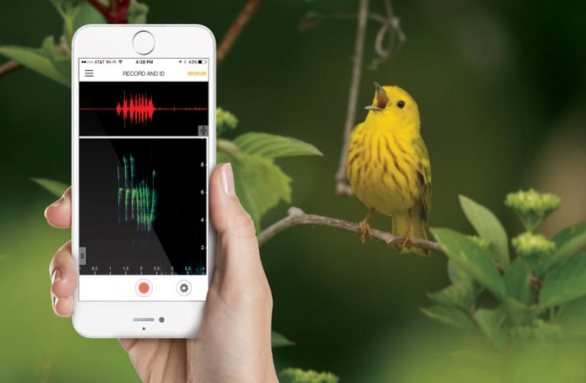
Proposal:
Automated Bioacoustics Analysis Platform
Ming Zhong
Rahul Dodhia
Juan Lavista Ferres
AI for Good Research Lab
Notes:
Common problems in bioacoustics community

Slide 2
Main Interest of Leveraging ML Tools in Acoustics
Acoustics projects we have worked so far:
Marine mammal calls and anthropogenic sound classification
Multiple birds and amphibians call classification
Vessel type classification
Weapon type classification
According to acoustics-related papers published in JASA since 2018:
Classification/detection/identification (117 related papers): automated sound detection and species classification
Localization (27 related papers): source localization (of animals or vessels)
Segmentation (3 related papers): use bounding box methods to segment species calls
Notes:
Quick recap
Email surveys to collaborators

Slide 3
The need of Building an automated Acoustics Analysis Platform
Enable us (AI4E, AI4G Research Lab) to help broader audience in acoustics community working on problems that can be solved by similar methods (species classification).
Help conservation organizations and ecology practitioners to process audio recordings by detecting species presence more efficiently and more consistently.
This proposed platform will help acoustics/ecology community advancing fusion with ML techniques.
This proposed platform will help set-up standardized acoustics data format for annotations and ML analysis.
Notes:
Species: marine mammals, land species
Data format standardization: alignment and joint efforts needed among multiple collaborators

Slide 4
Similar Proposals and Existing Platforms
Similar proposals submitted to AI4E:
From Conservation X Labs and the Nowacek Lab (Duke University)
From Center for Conservation Bioacoustics – Cornell Lab of Ornithology
Existing platforms that I know:
From our existing collaborators:
Arbimon (by Rainforest Connection)
Songs of Adaptation
Ketos by Meridian*
Other: PAMGuard, Song Scope, Kaleidoscope, etc.
Notes:
None of these existing platforms are widely used, either they are built for specific species, or with high false positive rate

Slide 5
Scope of the Proposed Platform: Near-Term Plan
Target Users: Organizations, researchers and data scientists working with acoustics data (audio recordings and verified labels).
Near-term plan:
Standardize data format for annotations and model training.
Build API with species classification modeling (supervised learning method) and batch processing functions.
Documentation with step-by-step tutorial.
Host sample datasets on Azure to enable users to learn how to use the platform.
A couple of pre-trained models (like BirdNET) that users can upload their own data for detection*.

Slide 6
Scope of the Proposed Platform: Long-Term Plan
Target Users: broader ecology community with acoustics data (audio recordings).
Long-term plan:
Unsupervised learning for sound clustering and species discovery.
Build open-source queryable audio database with labeled sounds for multiple categories (animals, vessels, anthropogenic sounds) hosted by Azure.
Provide users pre-trained models with the flexibility of users query relevant species only to build customized models.
Notes:
similar to Camera Trap

Slide 7
Key Modules of the Proposed Platform (Near-Term Plan)
Data Pre-processing: process the raw audio files to spectrograms; data augmentation; data split.
Classification modeling: include binary & multi-class classification model options
Model Output and Visualization:
Model performance metrics
Output files with predicted probabilities
Visualization options
Notes:
Similar functions to ketos

Slide 8
Collaboration Options
AI4E + AI4G Research Lab
Collaborate with Cornell, Duke, and Meridian
Other organizations & research labs that are willing to contribute (e.g., NOAA)

Slide 9
Concerns
Data sharing resistance
Limited data from single organization or user
Model building may not be completely automated
Scalability
Notes:
Data sharing resistance: some people in the community of ecology and acoustics are very resistant to share, or even upload their data to a platform
Limited data from single organization or user: for the near-term plan, this platform will not include a pre-trained model for every species. The users need to upload their own data for model training, while we need to advice them that they should have at least certain size of labeled data or use specialized classification models in order to train get reasonably good results.
Model building may not be completely automated: Depending on datasets, different methodology may be needed (for example, data augmentation, models) and the users may need to tune parameters (batch size, learning rate, optimizer, etc.).
Scalability: how many organizations are going to use this platform and what is our capacity to support these users to answer their questions, to show them how to use the platform step by step, etc.

Slide 10
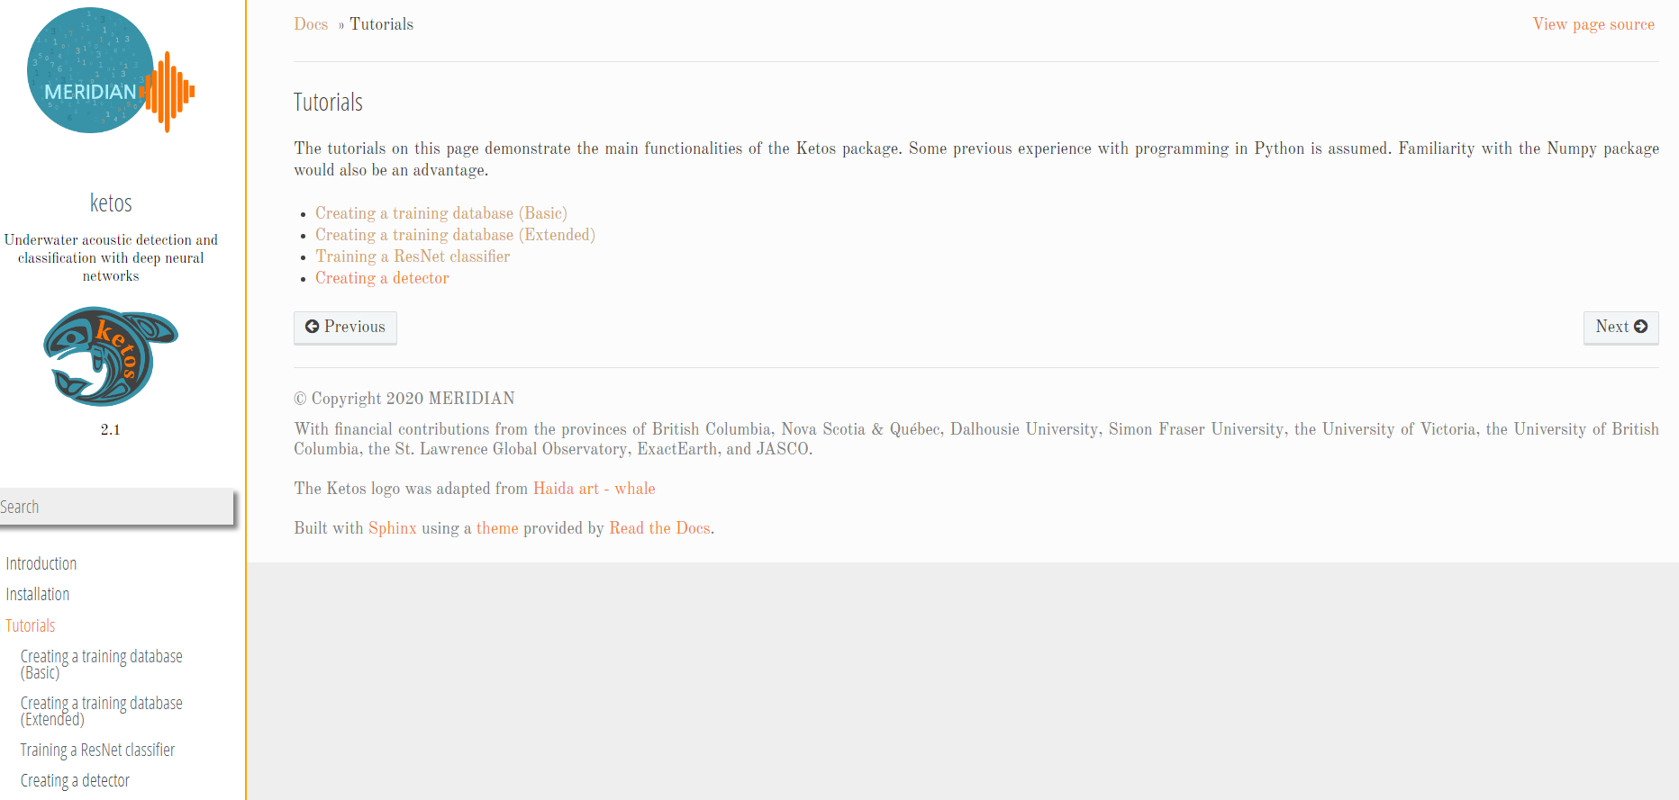
Appendix – Ketos (model training platform)

Slide 11
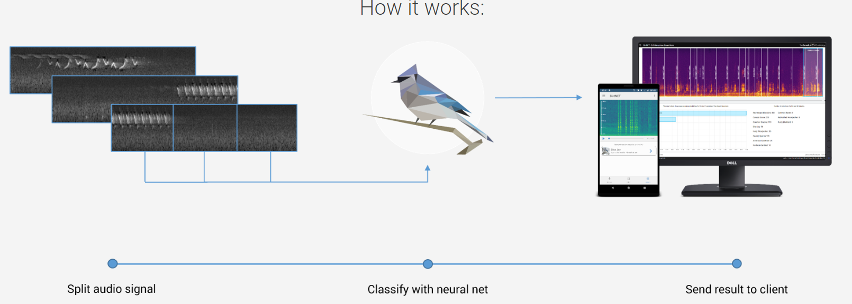
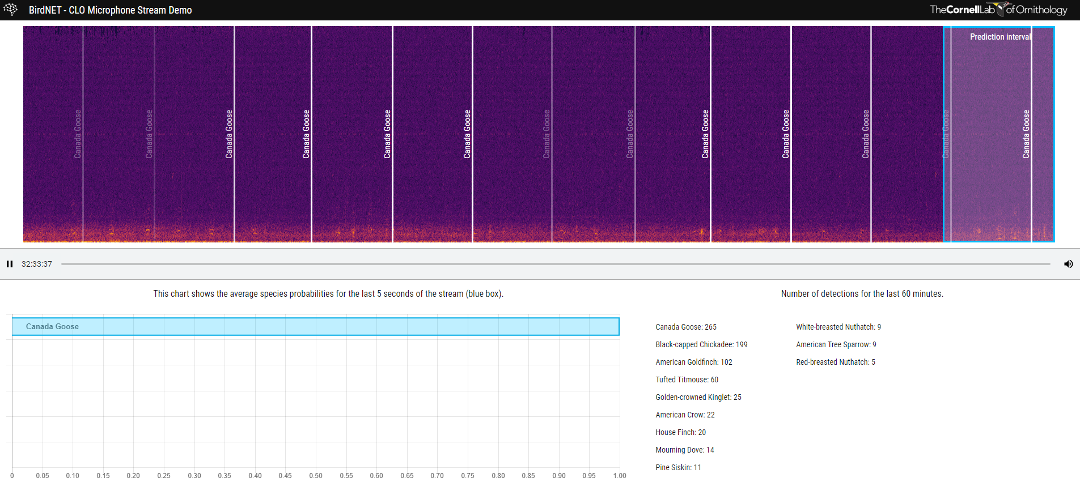
Appendix – BirdNET (pre-trained model)

